Slide 1



Pratyaksh: The Data Visualization Challenge
View in Power BI
College:
National Institute of Technology, Trichy
Submitted By:
Mahesh Nanavare
Harshal Babar

Slide 2
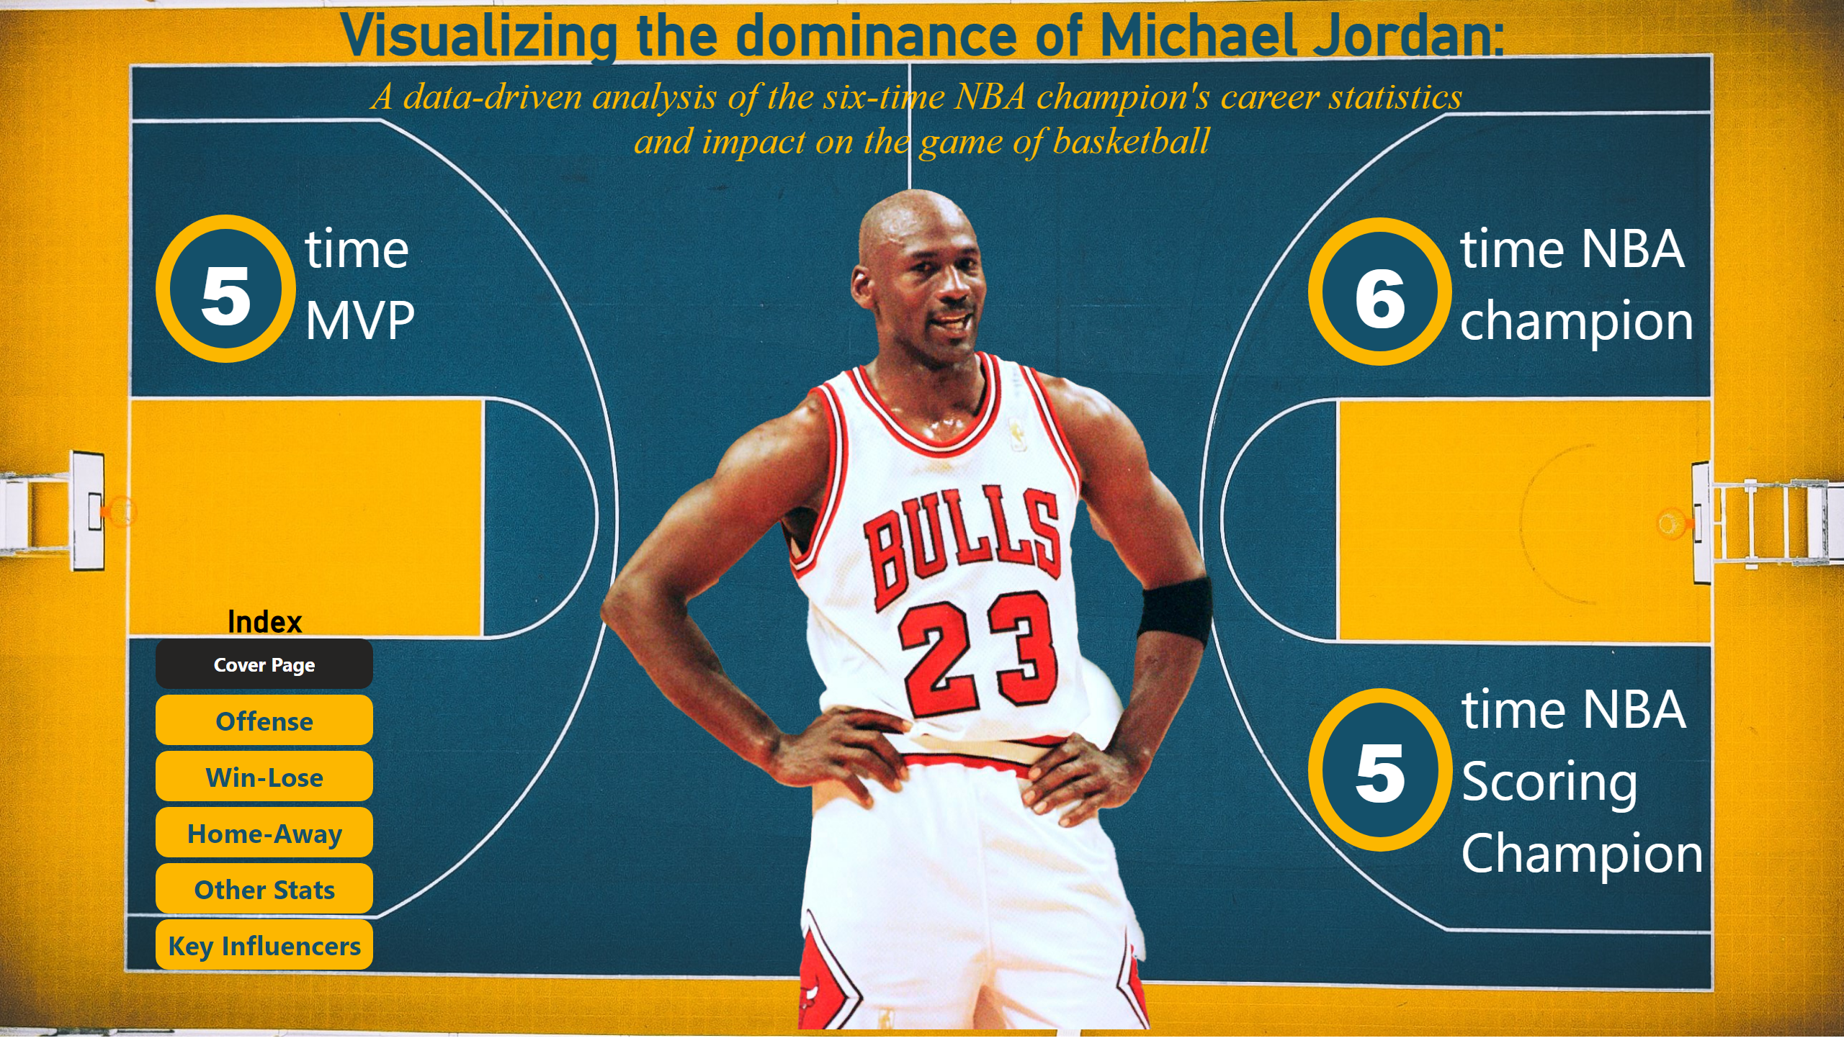
Cover Page
Notes:
image
No alt text provided
Visualizing the dominance of Michael Jordan:
No alt text provided
textbox
No alt text provided
shape
No alt text provided
textbox
No alt text provided
shape
No alt text provided
textbox
No alt text provided
shape
No alt text provided
Index
No alt text provided

Slide 3
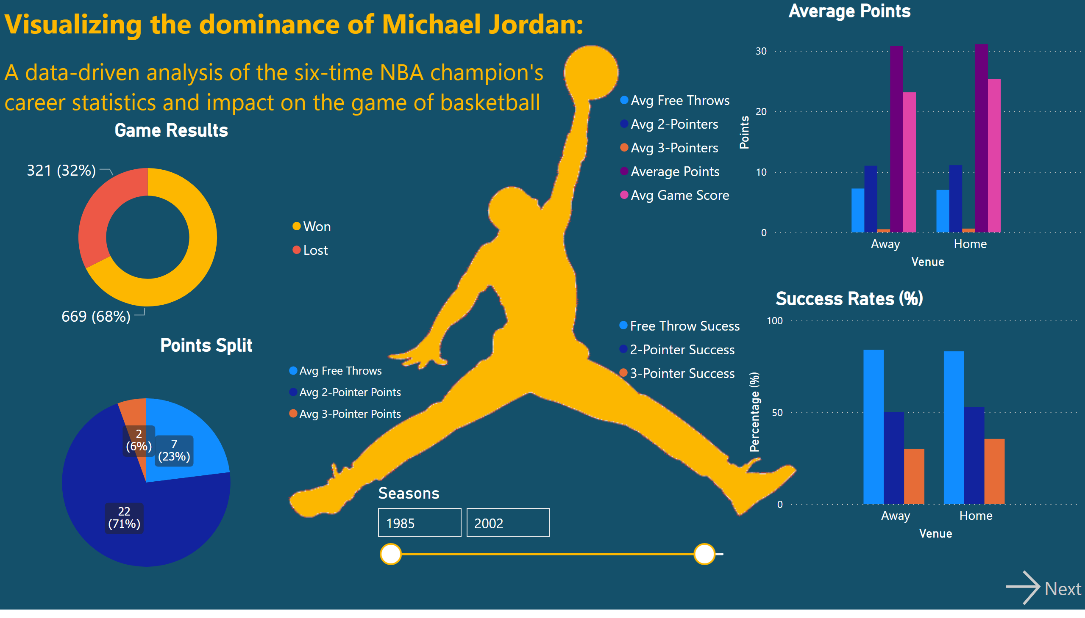
Offense
Notes:
textbox
No alt text provided
Game Results
No alt text provided
actionButton
No alt text provided
slicer
No alt text provided
Points Split
No alt text provided
Average Points
No alt text provided
Success Rates (%)
No alt text provided

Slide 4
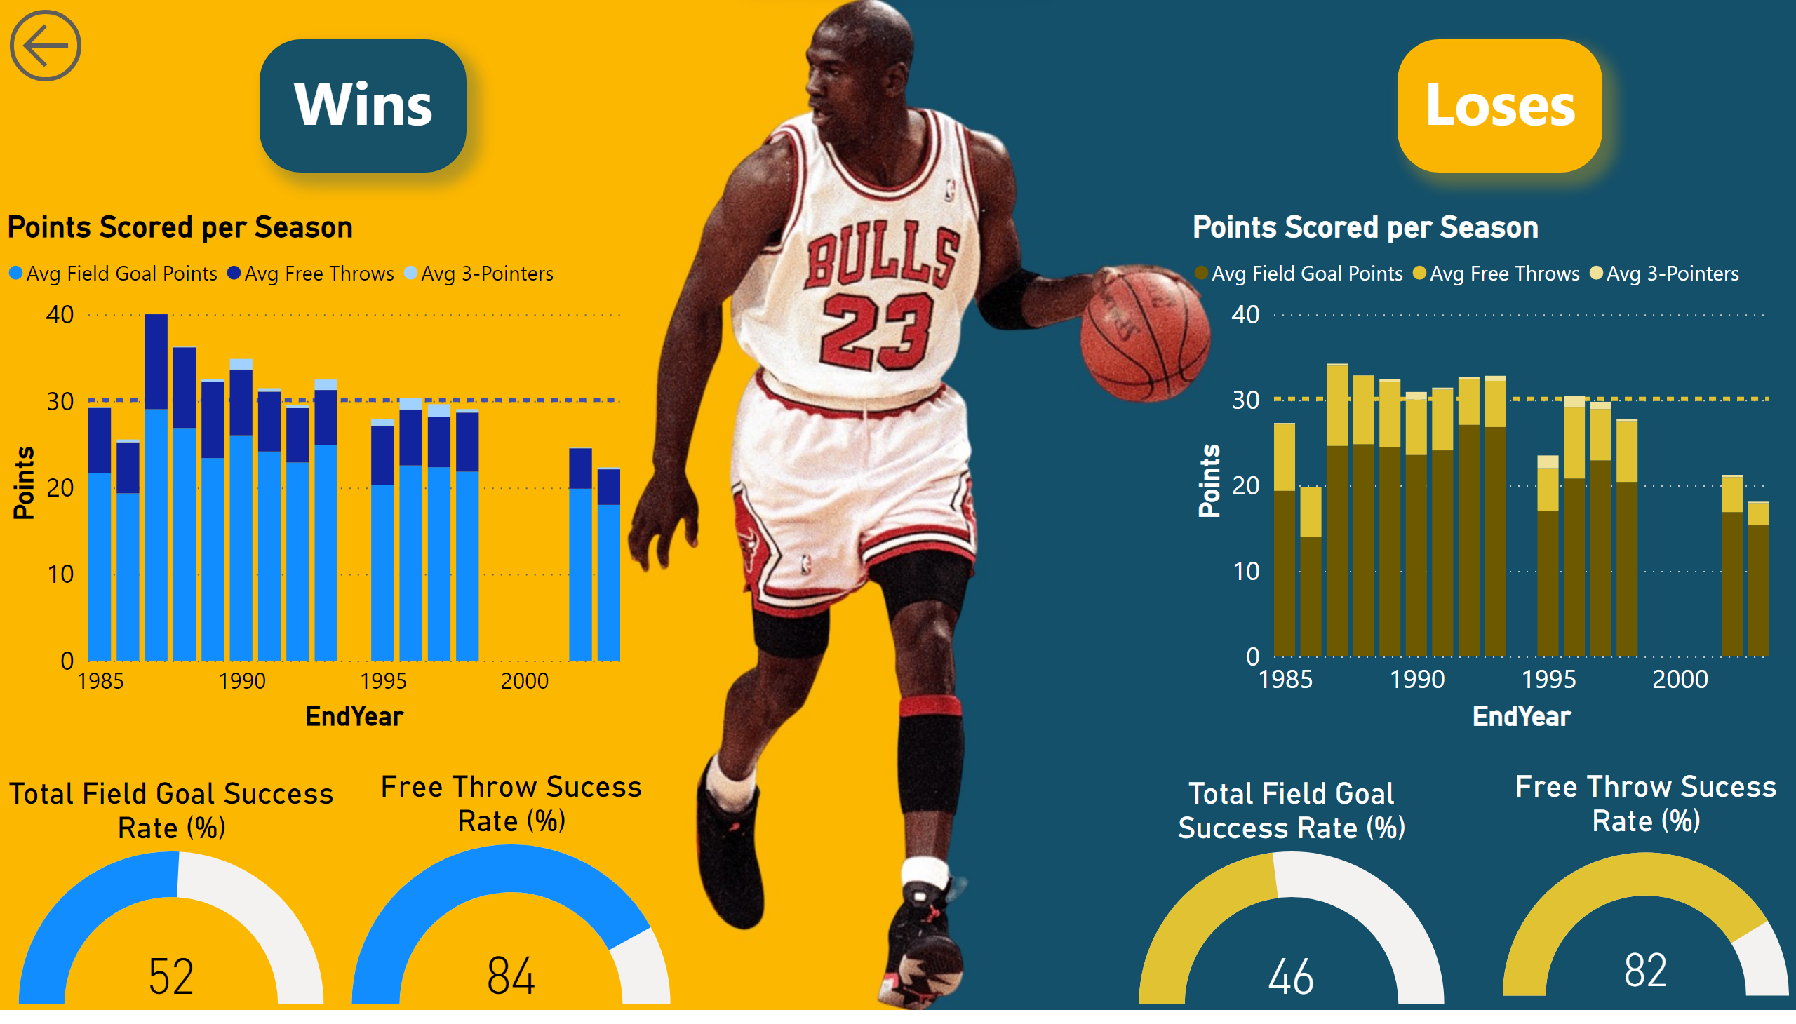
Win-Lose
Notes:
actionButton
No alt text provided
textbox
No alt text provided
textbox
No alt text provided
Points Scored per Season
No alt text provided
Points Scored per Season
No alt text provided
Free Throw Sucess Rate (%)
No alt text provided
gauge
No alt text provided
Free Throw Sucess Rate (%)
No alt text provided
gauge
No alt text provided

Slide 5
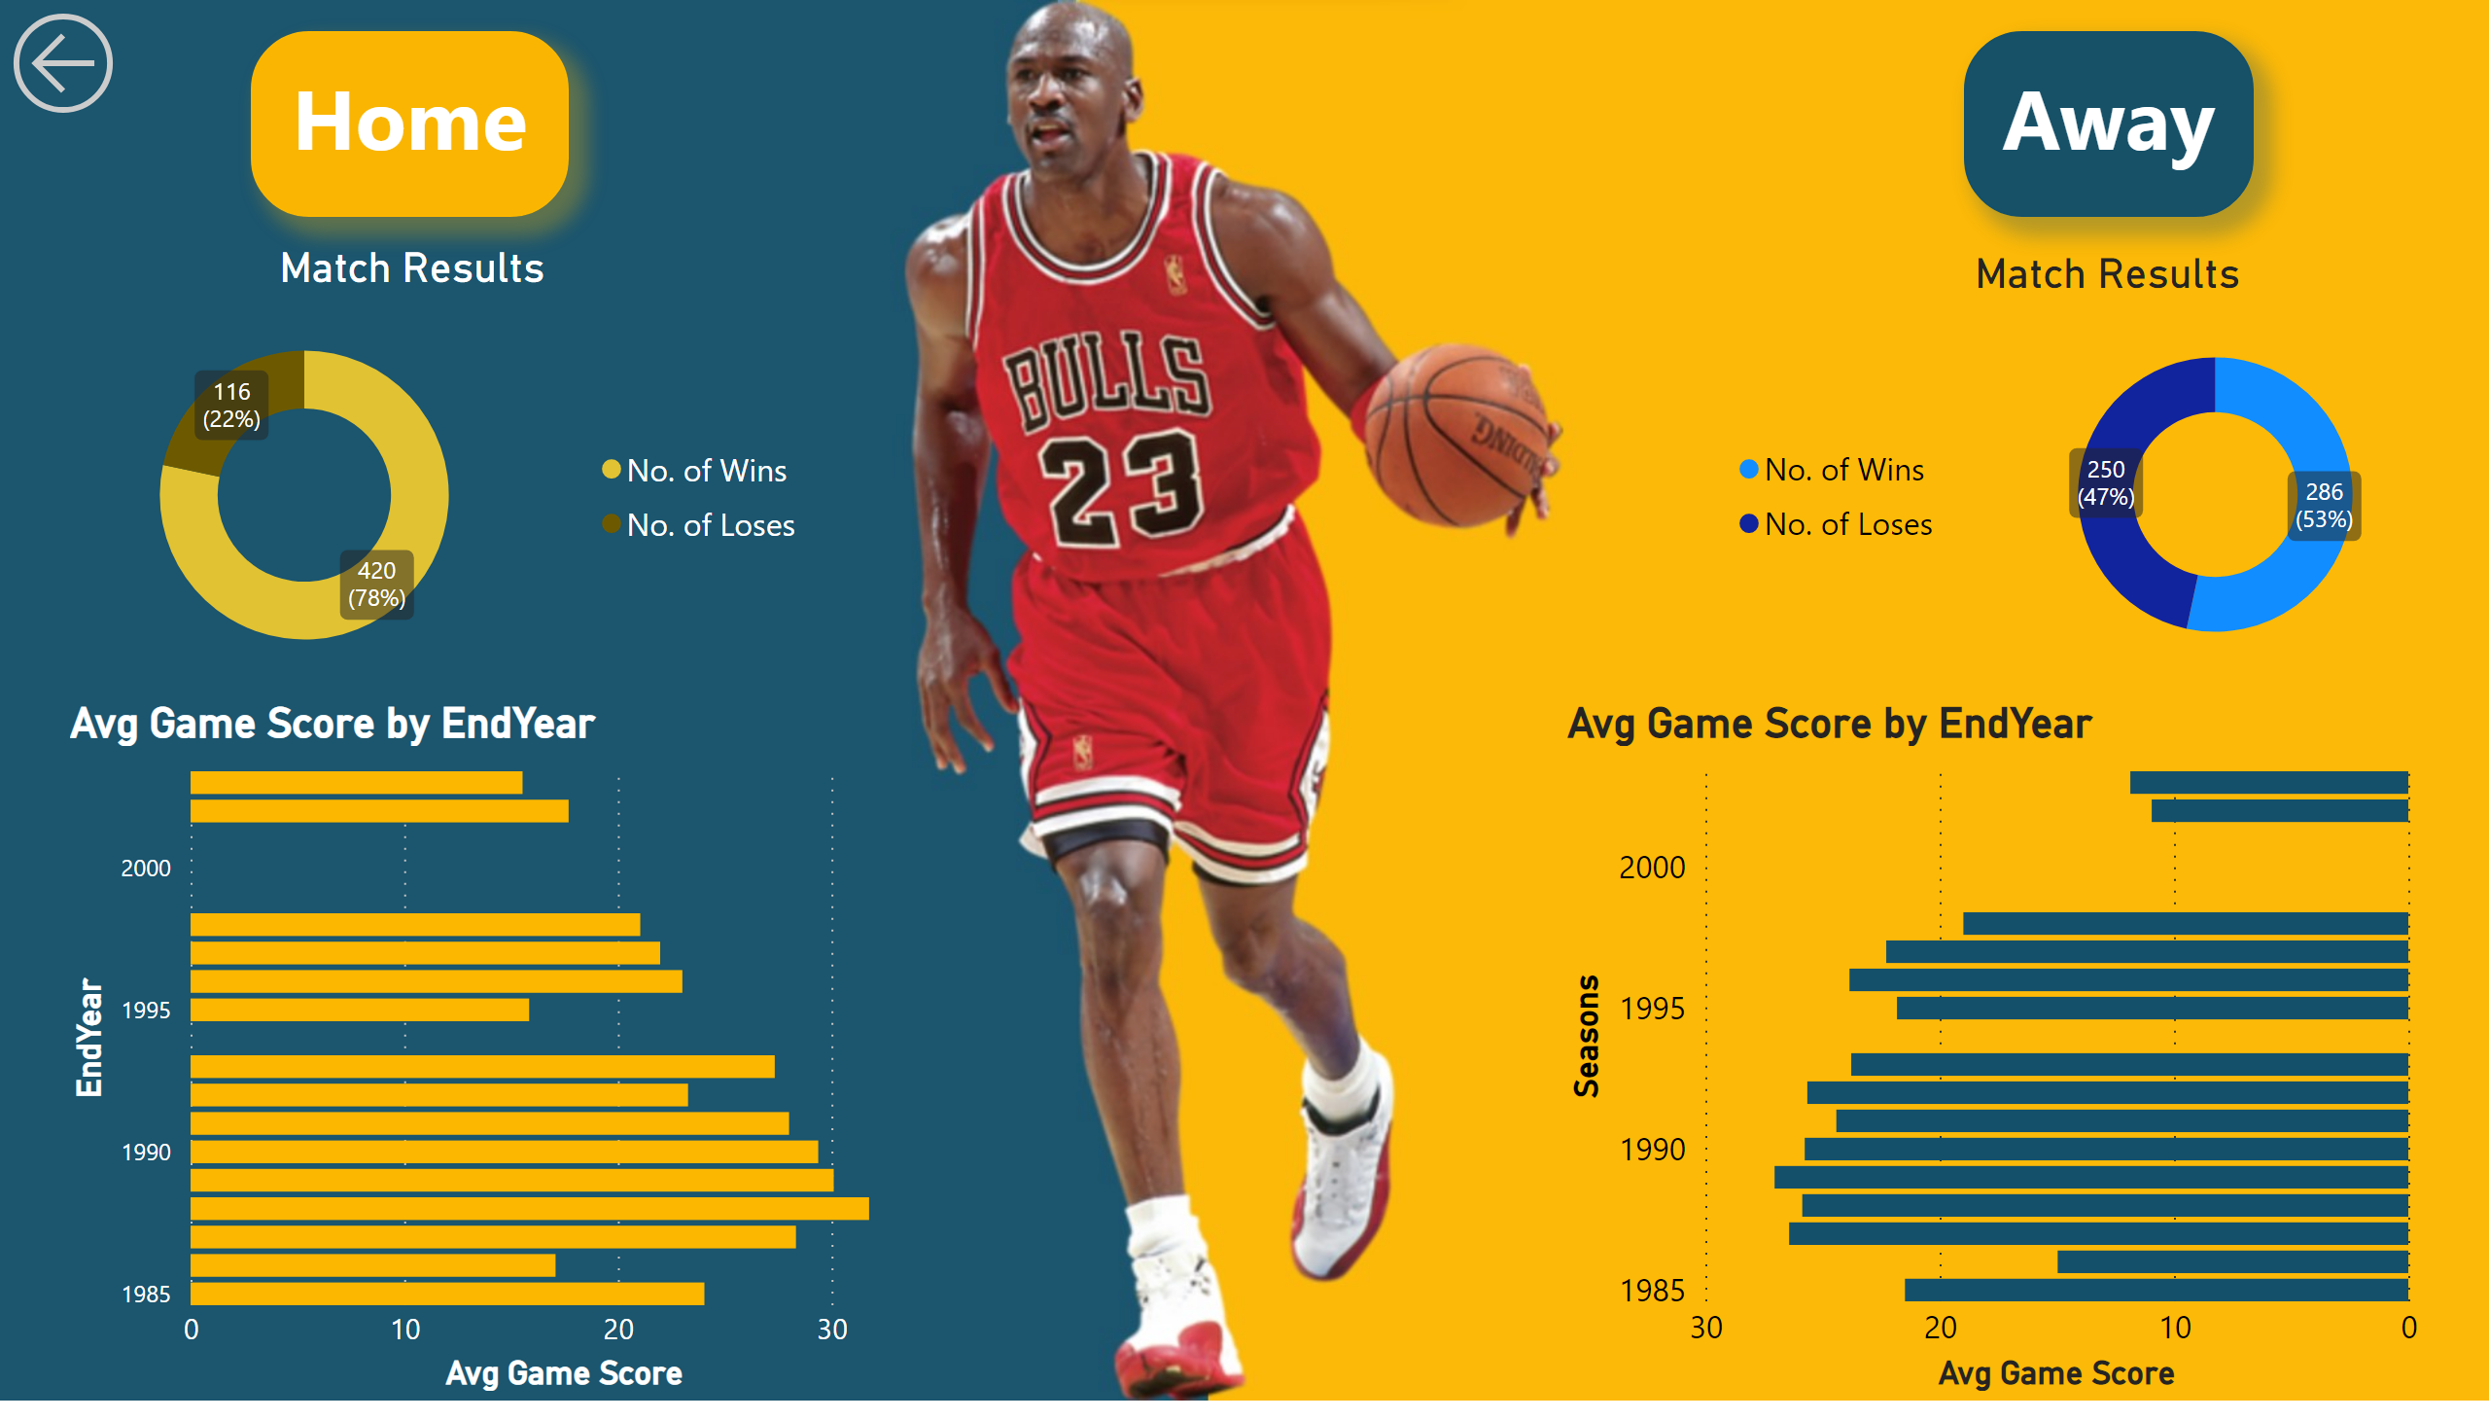
Home-Away
Notes:
textbox
No alt text provided
textbox
No alt text provided
Match Results
No alt text provided
Match Results
No alt text provided
actionButton
No alt text provided
clusteredBarChart
No alt text provided
clusteredBarChart
No alt text provided

Slide 6
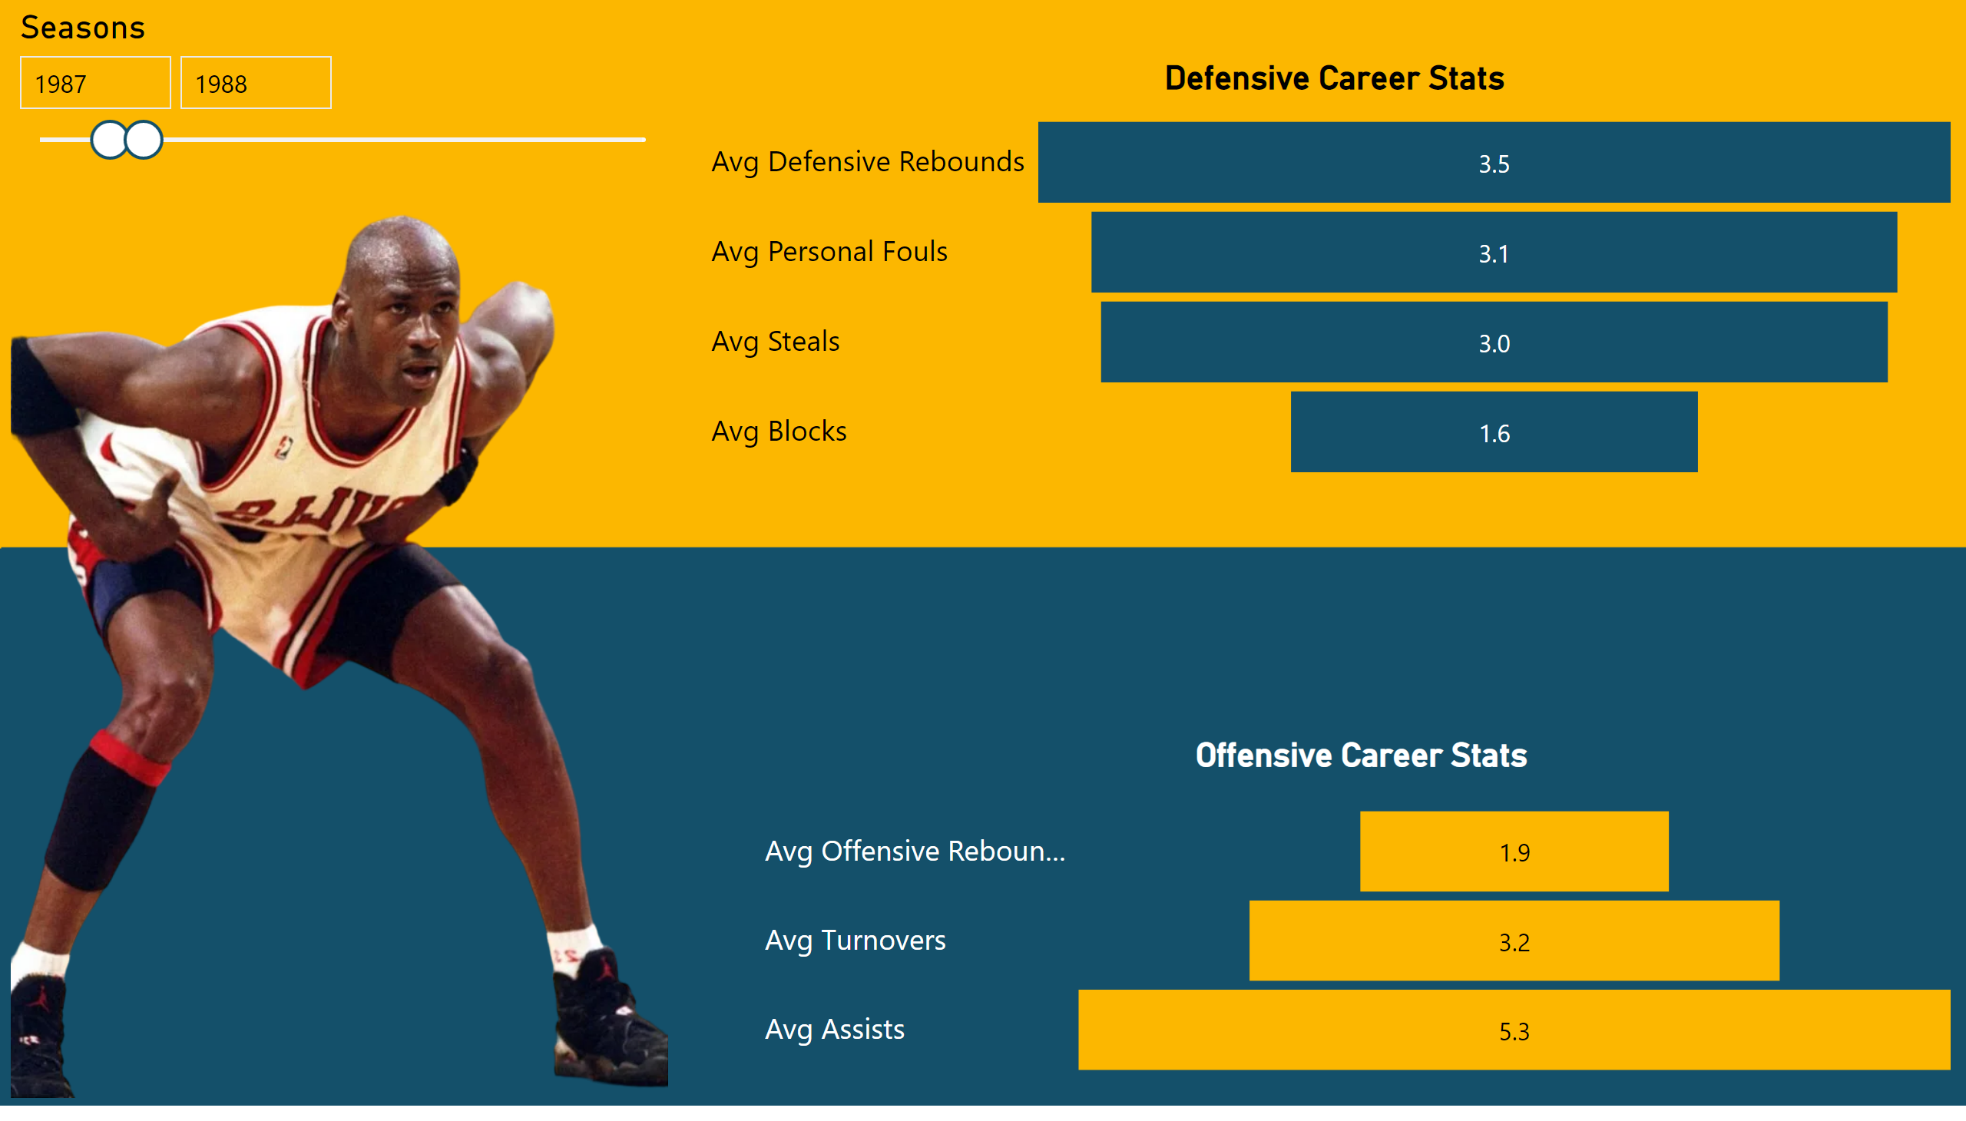
Other Stats
Notes:
image
No alt text provided
Defensive Career Stats
No alt text provided
Offensive Career Stats
No alt text provided
slicer
No alt text provided

Slide 7
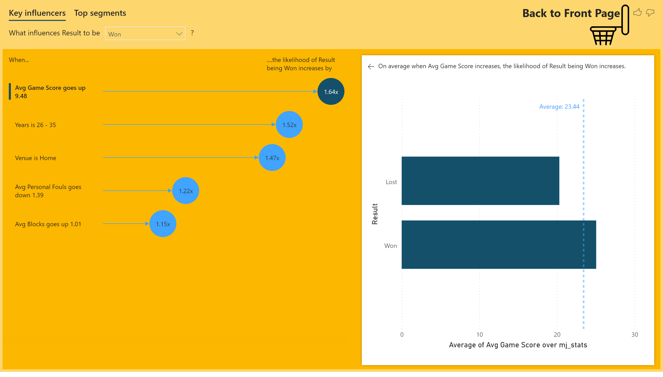
Key Influencers
Notes:
No alt text provided
image
No alt text provided
textbox
No alt text provided

